Slide 1
Test Driven Development microskills
@LlewellynFalco
WiFi: EPAMGUEST EPAMGUEST5 User: azeoke-szoke Password: y7QtTyyfY

Slide 2
Getting to know each other
Lines

Slide 3
Coding Exercises
github.com/approvals
ApprovalTests.java.StarterProject
ApprovalTests.Net.StarterProject
ApprovalTests.Python.StarterProject
ApprovalTests.js.StarterProject
ApprovalTests.cpp.StarterProject
Eclipse / intelliJ
#Resharper
PyCharm
WebStorm
Clion / Resharper C++

Slide 4
Check In
Pairs

Slide 5
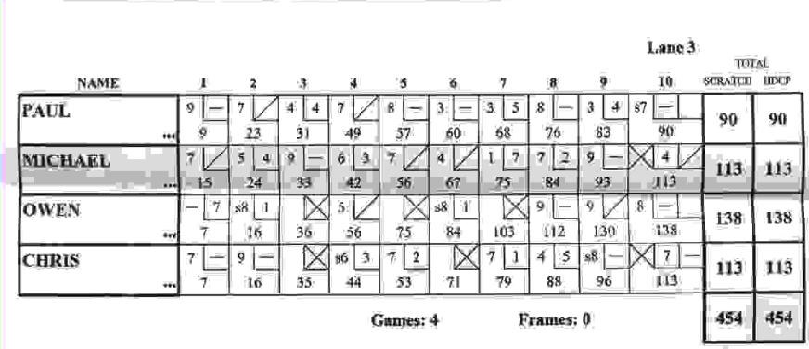
Bowling

Slide 7
Writing scenarios
Paper

Slide 8
1. Minesweeper
2. othello (reversi)
3. chess
4. snake
5. checkers
6. battleship
7. natural sort
8. family tree
9. Shopping receipt
10. Anagrams
11. Bank account

Slide 9
Transforming scenarios to steps
Code/Google

Slide 10
Crafting thru tests
Demo

Slide 11
Consume 1st programming
Google

Slide 12
Visualizing State
Google

Slide 13
Using your Editor effectively
Mob

Slide 14
Using Coverage
Functional

Slide 15
Separating code
Peel & Slice

Slide 16
Removing Duplication
Pairs

Slide 17
Fake it till you make it
Pairs

Slide 18
Check In
Mob

Slide 19
VS Code & Partial Diff

Slide 20

Contact Information
@LlewellynFalco http://LlewellynFalco.Blogspot.com
http://www.approvaltests.com
Please connect on
twitter & linkedIn
Notes:
Both

